Slide 1
Introduction to Components

Slide 2
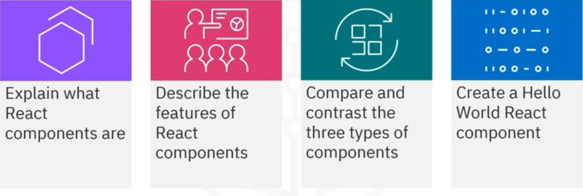
What you will learn

Slide 3
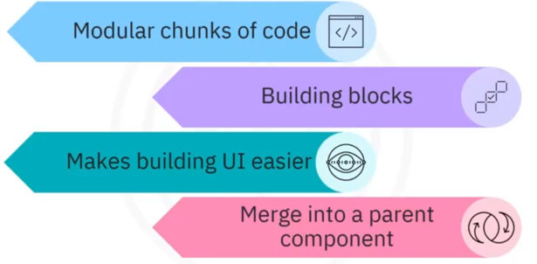
What is a component?

Slide 4
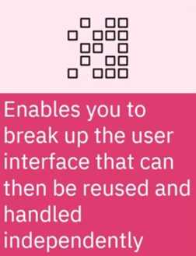
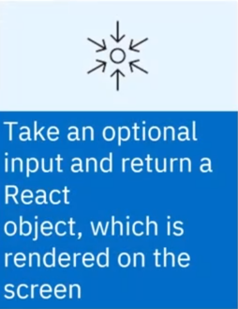
More about components

Slide 5


Purpose

Slide 6
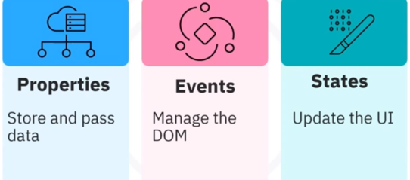
Component Features

Slide 7


Functional Components

Slide 8
Function component example
const Democomponent = ( ) =>
{
return<h1>We1come Message!</hl>;
}

Slide 9
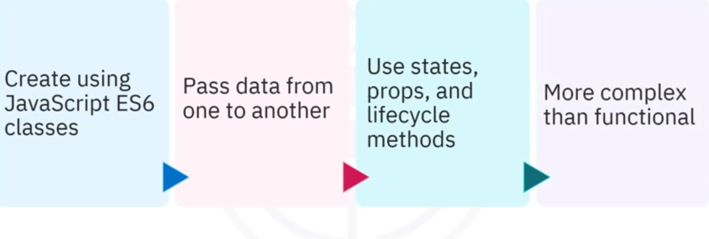
Class Components

Slide 10
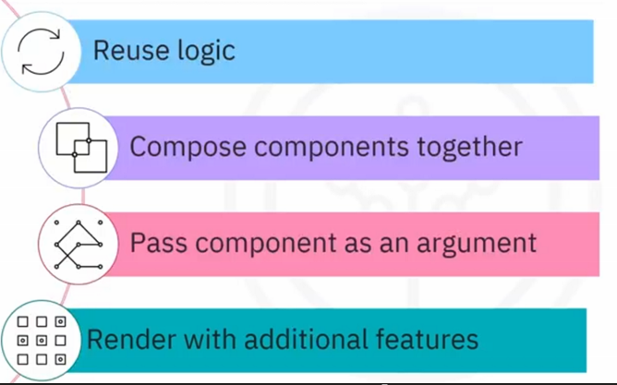
Higher-Order Component

Slide 11
Recap
In this video, you learned that:
• You create React applications with modular code called
components
• Components break up the user interface into separate parts
that you can reuse and handle independently
• A React component:
• Renders the initial user interface
• Manages and handles events
• Updates the user interface according to its state
• The three types of React components include functional, class,
and higher-order

